Slide 1
KZN Ward-Level Voter Turnout Predictor (2000–2026)
DIRISA SDC Student Datathon Challenge
Project Team: SPU DIRISA Team
Focus Province: KwaZulu-Natal (KZN), South Africa
Spatial Unit of Analysis: 921 Wards across 54 Local Municipalities
Live Interactive Dashboard: SPU Election Turnout Predictor KZN

Slide 2
Overview
Our team did not simply select an abstract, theoretical problem from a textbook or rely on speculative assumptions. We committed ourselves to comprehensive, exhaustive empirical ground work focused entirely on the province of KwaZulu-Natal (KZN), South Africa's second-most populous economic and political hub. Over multiple days of forensic data investigation, we harmonized 21 years of longitudinal ward election records spanning five municipal cycles (2000, 2006, 2011, 2016, and 2021) across all 921 wards in the province. We cross-referenced these voting trends against Statistics South Africa labor surveys, Census multidimensional poverty indices, and municipal infrastructure assessments.
21 years of ward election data
5 cycles
2000 → 2021
921 wards across KZN
1 province
Pipeline scope:
Multi-source data provenance & ingestion • Rigorous 4-check data cleaning • Crosswalk boundary harmonization • Unified data architecture (2 final datasets) • Population coverage & non-voter analytics • Strict target leakage prevention • Time-series evaluation & benchmark modeling • Negative finding discovery • 2026 deployment hand-off

Slide 3
Problem Statement and Solution
PROBLEM STATEMENT
SOLUTION STATEMENT
Voter turnout in KwaZulu-Natal is declining across election cycles, raising concerns about civic participation and electoral legitimacy.
Turnout fell to about 45% in the 2021 municipal elections, compared with stronger participation in earlier elections.
Our analysis links low participation to deeper socioeconomic challenges, including youth unemployment, poverty, and declining municipal services.
Stakeholders lack granular data and foresight to effectively address turnout challenges ahead of the 2026 Local Government Elections.
Built a machine-learning model using ward-level election data from 2000–2021 to predict voter turnout.
Combined multiple datasets, including election results, unemployment, poverty, and municipal infrastructure indicators.
Created the SPU Election Turnout Predictor KZN, an interactive dashboard for non-technical decision-makers.
Enables geographic drill-down across 11 districts, 54 municipalities, and 921 wards.
Allows data exports of filtered results or the full 2026 prediction dataset.
Future goal: Expand from KZN’s 921 wards to all 4,468 wards across South Africa.

Slide 4
Sources and Data collection
IEC Downloadable Municipal Results (2000, 2006, 2011, 2016, 2021): Official Electoral Commission of South Africa portal. Ballots cast, valid votes, and registered voters per voting district and ward.
IEC Voter Registration Roll Snapshot (2026): Extracted from the IEC official statistics portal, covering 921 KZN wards.
Stats SA Census (2011 & 2022): Population headcounts, gender distribution, and dwelling/household geography (Urban, Tribal/Traditional, Farm) aggregated to municipality.
Stats SA Poverty & Inequality Indicators (2011–2023): Upper-Bound Poverty Line (UBPL) and Lower-Bound Poverty Line (LBPL) headcounts and Gini coefficients across KZN municipalities.
Stats SA Quarterly Labour Force Survey (QLFS Q1 2024): Metro (eThekwini) vs. non-metro employment, absorption, and labour force participation rates.
Afrobarometer Round 9 / 2024 Political Attitudes: Survey on institutional trust (IEC, National/Provincial Government) and democratic satisfaction (N=319 for KZN).
6
Institutional data sources harmonized
921
KZN wards, 5 election cycles (2000–2021)

Slide 5
Cleaning, Merging & Harmonization
4-CHECK DATA CLEANSING
LONGITUDINAL WARD HARMONIZATION
Missing Values: Identifying and resolving structural vs. incidental null values.
Inconsistent Formats: Standardizing column naming conventions (PascalCase/snake_case), normalizing ward codes to 8-digit integers, and converting percentages.
Wrong Data Types: Enforcing strict casting of vote tallies to integers, rates to floats, and ward identifiers to consistent types.
Duplicates & Junk Rows: Pruning provincial aggregate summary rows, repeated headers, and malformed empty entries.
Implements geographic boundary harmonization by projecting historical Voting District (VD) results from 2000, 2006, 2011, and 2016 into the official 2021 Municipal Demarcation Board (MDB) reference wards.
South African ward boundaries are redrawn by the MDB prior to every local government election; wards split, merge, and shift across municipal borders.
Using the crosswalk, VD-level votes cast and registered voters from each historical election are aggregated into 2021 reference boundaries, establishing a scientifically valid 5-election panel.
4,462 records
Dataset (a): unified ward historical training panel, 2000–2021

Slide 6
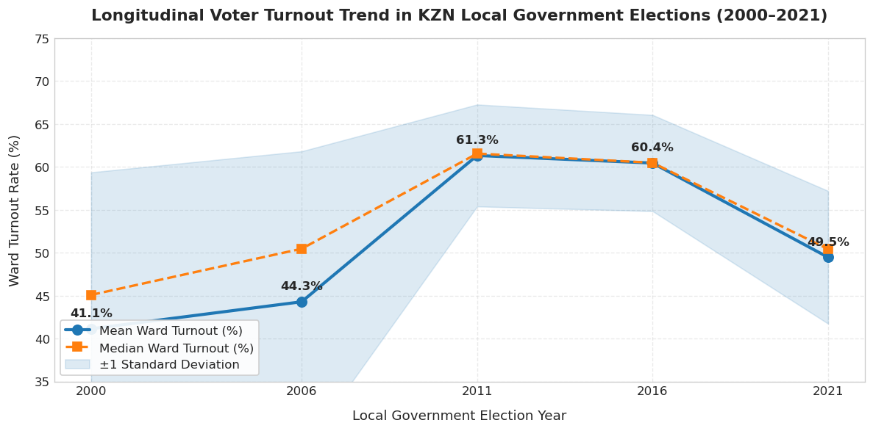
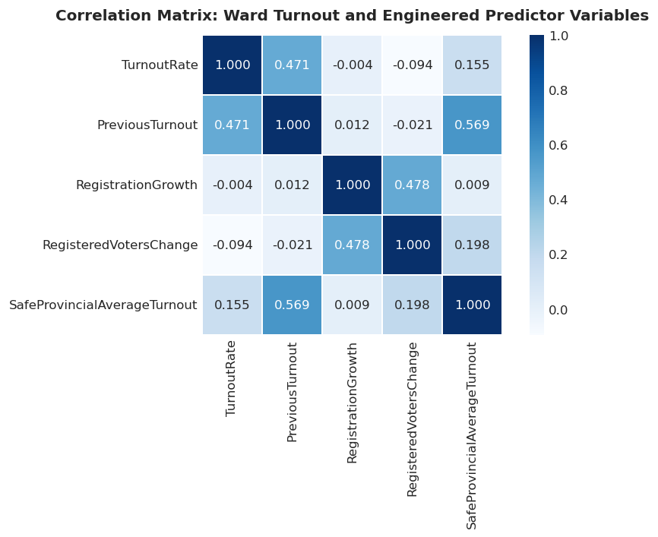
EDA & Visualisation
LONGITUDINAL TURNOUT TRAJECTORY (2000–2021)
KZN local turnout climbed from 41.1% (2000) to a peak of 61.3% in 2011, then fell 11.8 percentage points to 49.5% by 2021 — an acute, province-wide reversal in participation.
FEATURE CORRELATION HEATMAP
TurnoutRate correlates most strongly with PreviousTurnout (r = 0.471); SafeProvincialAverageTurnout has a weaker direct link (r = 0.155) but tracks PreviousTurnout closely (r = 0.569) — explaining why both features dominate the trained model despite differing raw correlations with turnout itself.

Slide 7
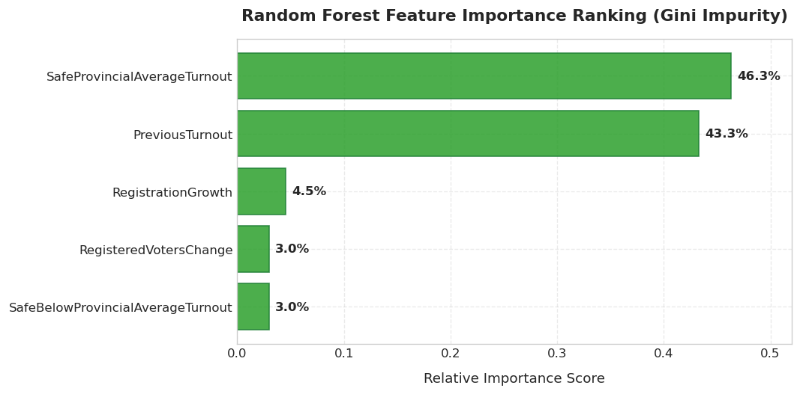
Feature Engineering & Importance
FEATURE ENGINEERING
FEATURE IMPORTANCE & INSIGHTS
Target Variable: TurnoutRate = Total Votes Cast ÷ Registered Voters × 100, engineered from the harmonized historical ward panel.
Lagged predictors — PreviousTurnout and PreviousRegistered — capture each ward's behaviour in the prior election (t−1), the strongest available signal of future turnout.
RegisteredVotersChange and RegistrationGrowth track voter-roll expansion between elections, since newly registered voters consistently turn out at lower rates.
Strict leakage prevention: current-year ProvincialAverageTurnout is replaced with SafeProvincialAverageTurnout, strictly lagged to t−1, so the model never sees the election it is predicting.
Gini-impurity feature importance ranking from the winning Random Forest model:
Turnout forecasting is governed overwhelmingly by two forces — provincial momentum (SafeProvincialAverageTurnout: 46.3%) and hyper-local persistence (PreviousTurnout: 43.3%) — followed by voter-roll change signals.

Slide 8
Model & Results
Held-out test: 901 KZN wards, 2021 election (strict temporal train/test split)
Model | MAE | RMSE | R²
Naive Historical Persistence Baseline | 11.1404 | 12.7010 | -1.6997
Random Forest (Ward History Features) | 9.9802 | 11.7199 | -1.2988
Random Forest (+ Municipal Context) | 10.3711 | — | —
The ensemble Random Forest reduces prediction error by 10.41% MAE and 7.72% RMSE over naive persistence, confirming genuine explanatory gain.
REPORTABLE NEGATIVE FINDING
Adding municipal demographics worsened held-out test MAE from 9.9802 to 10.3711 percentage points (+0.39 pp degradation). South African municipalities are vast and demographically heterogeneous — attaching a single municipal statistic across all constituent wards introduces ecological aggregation noise. Model 3 is explicitly rejected in favor of the parsimonious Model 2.

Slide 9
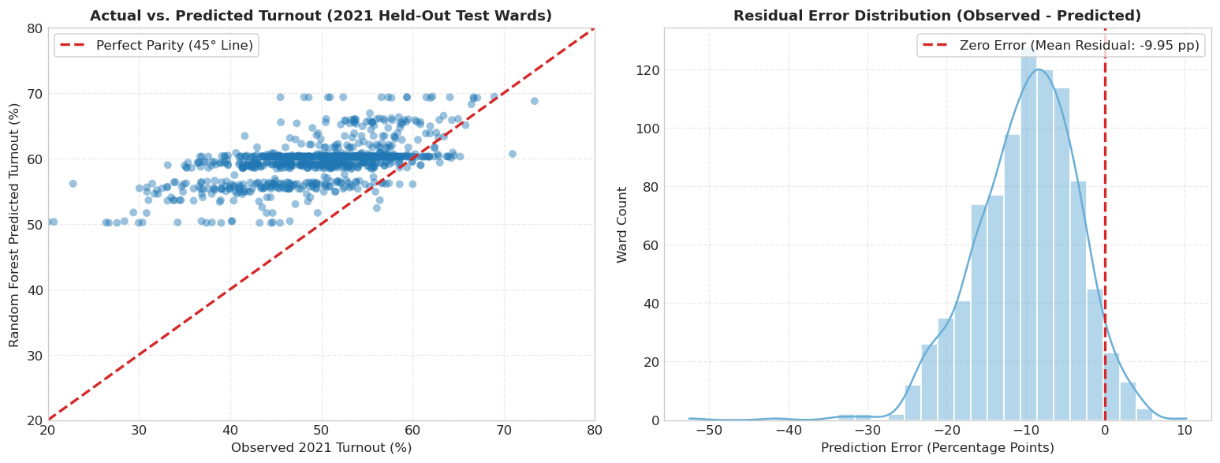
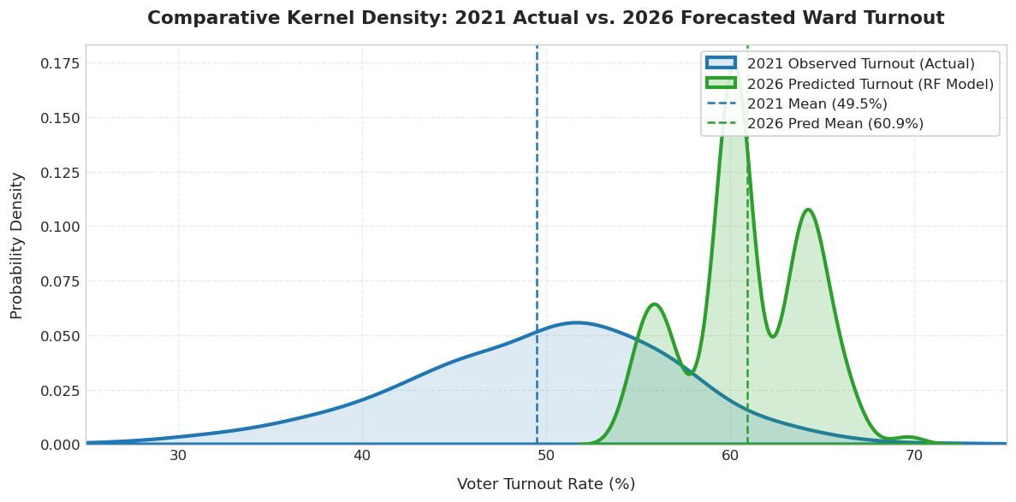
Model Diagnostics & 2026 Forecast
ACTUAL VS. PREDICTED & RESIDUALS (2021 HELD-OUT TEST)
Mean residual: −9.95pp — the model tends to over-predict turnout in lower-turnout wards, most visible across the 40%–60% core distribution.
2026 FORECAST DISTRIBUTION: OBSERVED VS. PREDICTED
The Random Forest projects a mean 2026 turnout of 60.9%, versus 49.5% observed in 2021 — a sizeable rightward shift worth sanity-checking against the pipeline's other 2026 estimates before release.

Slide 10
Who, Where & Gaps
WHO IS NOT VOTING?
Disaffected & Unregistered Youth (18–29)
Over 65% of the total non-voting population; expanded youth unemployment exceeds 40%.
Informal Settlement Dwellers
Persistent water shedding, uncollected refuse, and sewage overflows; abstention functions as protest.
Deep Rural Subsistence Households
Severe spatial distance to voting stations and entrenched rural poverty (>60% headcount) depress participation below 35%.
WHERE ARE THEY LOCATED?
THE GAPS
eThekwini Peri-Urban Belt: Severe apathy clusters surrounding Inanda, Ntuzuma, KwaMashu, Umlazi, and Mpumalanga township.
Northern Rural Traditional Authority Corridor: Umkhanyakude, Zululand, and King Cetshwayo, where historical turnout has dropped to 32–38%.
Post-Industrial Midland & Coal Corridor: Amajuba and Umzinyathi (Newcastle, Dannhauser, Endumeni) suffering long-term industrial job losses.
2,394,807
Turnout Gap: registered non-voters, 2026
>2.1M
Registration Gap: eligible unregistered adults

Slide 11
Limitation & Deployment
HONEST DATA LIMITATIONS & ENGINEERING MITIGATIONS
Data Limitation | Engineering Mitigation
Dashboard-only data: Data is spread across PDFs, dashboards and non-standard Excel files. | Built automated extractors and used MD5 checksums to validate data.
Ward boundary changes: Ward codes changed between 2000–2021. | Used spatial mapping to link historical Voting Districts to 2021 ward boundaries.
Limited Census data: Ward-level population data is not consistently available. | Used municipal/district population baselines with ward-level weighting.
Rounded service-delivery data: Some indicators are rounded or missing. | Converted metrics into continuous ratings and documented the transformation.
Registration denominator bias: Turnout only measures registered voters, excluding eligible but unregistered people. | Added population data to show both the Turnout Gap and Registration Gap.
2026 uncertainty: Future events such as registration changes, campaigns, weather and service-delivery issues cannot be predicted from historical data. | Presented predictions as decision-support estimates, with scenarios and future model updates.
DEPLOYMENT
Live Application: SPU Election Turnout Predictor KZN hosted on Streamlit Community Cloud.
Interface: Cascading geographic drill-down (11 District Councils, 54 Local Municipalities, 921 Wards) with Dual Temporal Selection Mode.

Slide 12
Future Growth | In the future the model can grow to be used on a national scale and not only province based and limited to KZN, and that can be achieved by making use of the model to predict, and reviews and feedback.
Model Refinement | Collecting data from the stakeholders reviews and feedback will help with identifying where the model needs to improve
Predictive Expansion | Applying the improved model to predict beyond KwaZulu-Natal, from 921 wards to all 4468 wards across all 9 provinces
National Deployment | Deploy the platform nationally ahead of future elections to optimize ballot and revitalize democratic participation
Continuous Improvement | Integrate the review and feedback system as a permanent loop so model keeps on enhancing with every election cycle
Recommendations

Slide 13

Impact, References & Close
References & Roadmap
Live Dashboard: SPU Election Turnout Predictor KZN
National Scaling: Expansion from KwaZulu-Natal's 921 wards to a comprehensive national platform covering all 4,468 wards across all 9 South African provinces.
Summary of Deliverables & Achievements
Data Harmonization: Linked 20 years of changing ward boundaries using spatial mapping, creating a 5-election dataset (N=4,462).
Model Performance: Random Forest reduced prediction error by 10.41% (MAE) and 7.72% (RMSE) compared with the historical baseline.
Population Coverage: Combined population, registered voters and votes cast, revealing a 70.7% non-voting gap.
Key Discovery: Municipal-level socioeconomic data did not improve ward-level predictions, highlighting the importance of local voting history.
Final Output: Produced 2026 turnout predictions and risk categories for all 921 KZN wards.
Armed with this intelligence, authorities can optimize ballot allocation, target youth civic mobilization, and systematically revitalize democratic participation nationwide.

